Slide 1


Personal development Plan
Unit 2.3 Steps in Personal development template
Prepared by the research team

Slide 2
Welcome!!
Unit 2.3 Steps in personal development

Slide 3
Learning outcome
Students will be able to develop a personal development plan

Slide 4


Slide 5
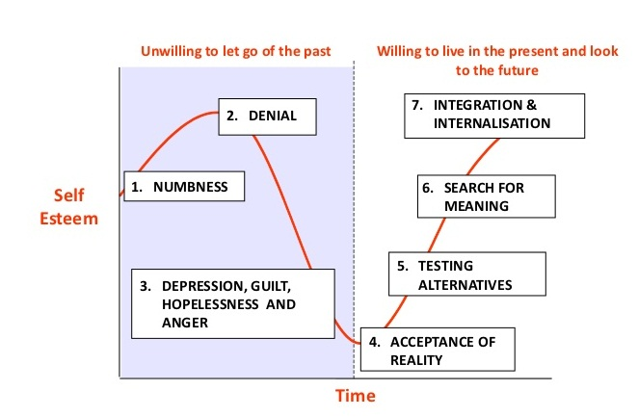
Most of us live in Stage 1,2 or 3 We will try today to reach Stage No.4

Slide 6


Take out your “Personal Development Plan” see template in folder

Slide 7
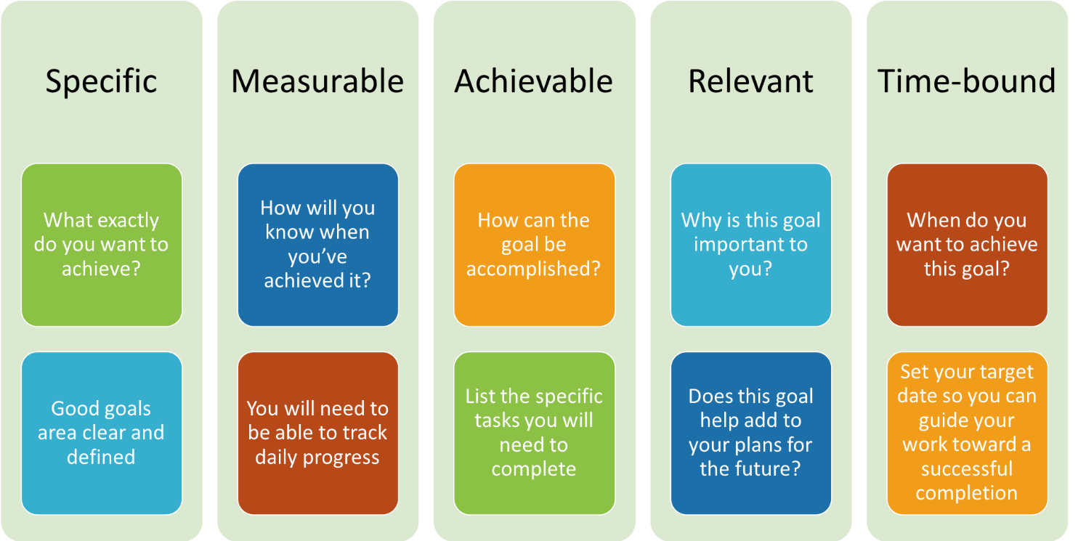
Smart goals

Slide 8
Do the activity sheet to learn how to SMART your goals

